Slide 1
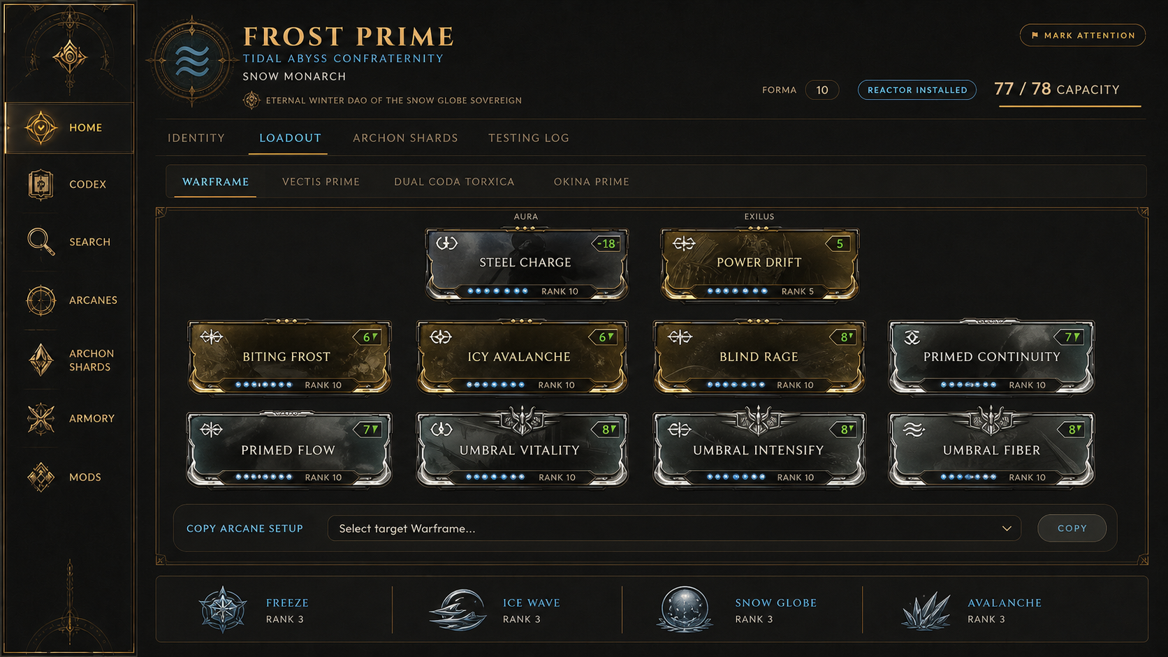
CEPHALON GU
THE
CULTIVATED
ARSENAL
Redesign discovery, visual direction, and implementation scope
KEEP THE CULTIVATION. SHARPEN THE INSTRUMENT.
27 AUGUST 2026
Notes:
[Sources]
- Docs/redesign/Cephalon Gu Redesign Report.md
- Docs/redesign/concepts/04-loadout.png
[/Sources]

Slide 2
CEPHALON GU
CAMPAIGN CONTRACT
02
The redesign changes hierarchy, not identity
Shipped behavior and game-accurate slot logic are fixed inputs.
IDENTITY
MECHANICS
SCOPE
Cephalon Gu
Cultivation-school lore
Warm dark palette
Cinzel and school colors
Build-card anatomy
Weapon: 4 × 2 + Exilus
Warframe/Melee: 2-4-4
Aura or Stance stays separate
Structured Riven rules
Warframe terminology
Current product only
Desktop-first
Mobile compatibility
Representative data
No live database writes
OUT OF SCOPE
No companion tracking or survivability-suite screens. No return to the old 14-button school filter.
Notes:
[Sources]
- User-approved redesign brief
- Docs/HANDOFF.md
- Docs/Cephalon_Gu_Master_Roadmap.md
[/Sources]

Slide 3
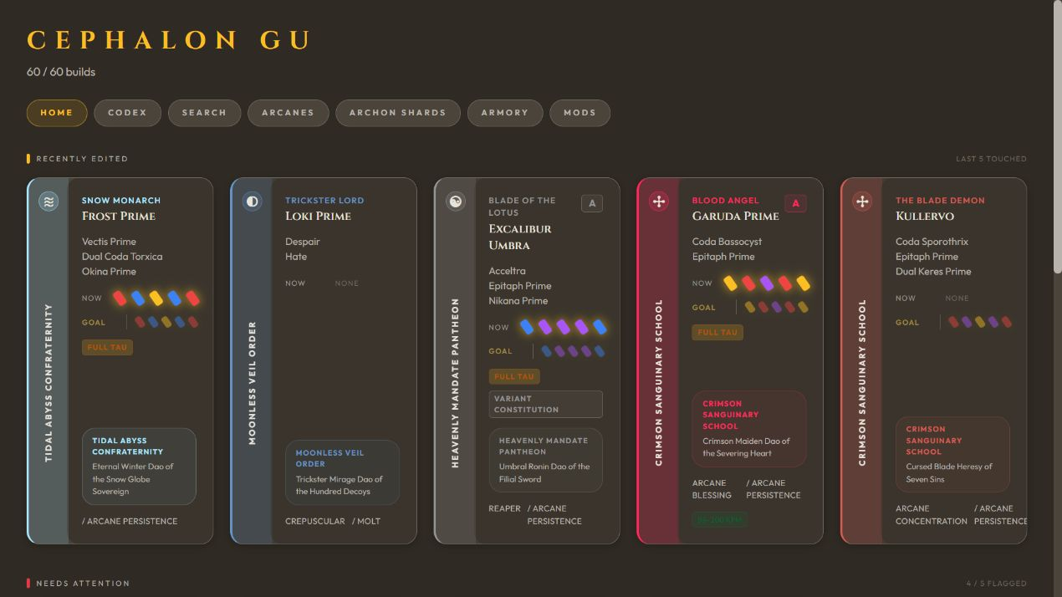
CEPHALON GU
CURRENT STATE
03
The product is distinctive, but every layer asks for equal attention
WHAT TO KEEP
School identity
Build-card anatomy
Warm, authored character
WHAT TO FIX
Competing controls
Repeated card boundaries
Weak scan order
Dense metadata without a lead
The problem is hierarchy and density, not a missing coat of paint.
Notes:
[Sources]
- Docs/redesign/before/home-desktop.png
- src/App.jsx
- src/index.css
[/Sources]

Slide 4
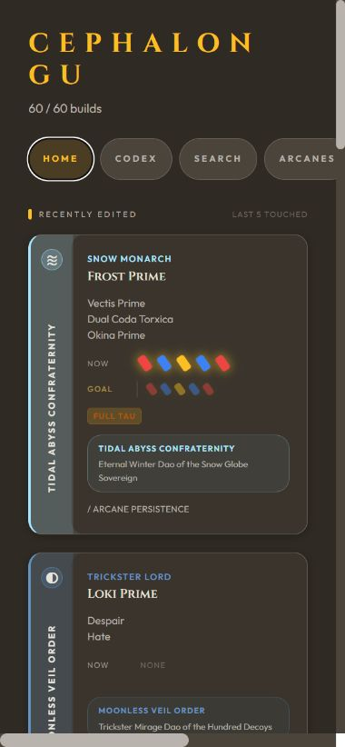
CEPHALON GU
AUDIT EVIDENCE
04
The current shell does not yet support a safe responsive migration
OBSERVED BASELINE
390 → 677 px
Viewport-to-content width; horizontal overflow
19 + 3
Lint errors and warnings
~567 KB
Main JavaScript bundle; chunk warning
25-30 sec
Several secondary populated screens
0 tests
No automated test script defined
Build passes. Populated major screens and loading states were observed. Empty, error, permission, destructive-confirmation, and save-result states still need controlled fixtures.
Notes:
[Sources]
- Local production build and lint output, 2026-08-27
- Docs/redesign/before/home-mobile-overflow.png
- package.json
[/Sources]

Slide 5
CEPHALON GU
DESIGN DIRECTION
05
A ritual instrument gives dense work a coherent order
Matte metal, parchment, engraved rules, and restrained school-color signals.
PAGE
SURFACE
RAISED
PARCHMENT
ASH
GOLD
DANGER
FOCUS
CULTIVATED
INTERACTION GRAMMAR
Command rail
Command band
Artifact plate
Inventory ledger
Arsenal grid
Focused inspector
Short engraved headings carry lore and place.
School colors identify content. Antique gold identifies interaction. Focus blue identifies keyboard position.
Notes:
[Sources]
- Docs/redesign/Cephalon Gu Redesign Report.md
[/Sources]

Slide 6
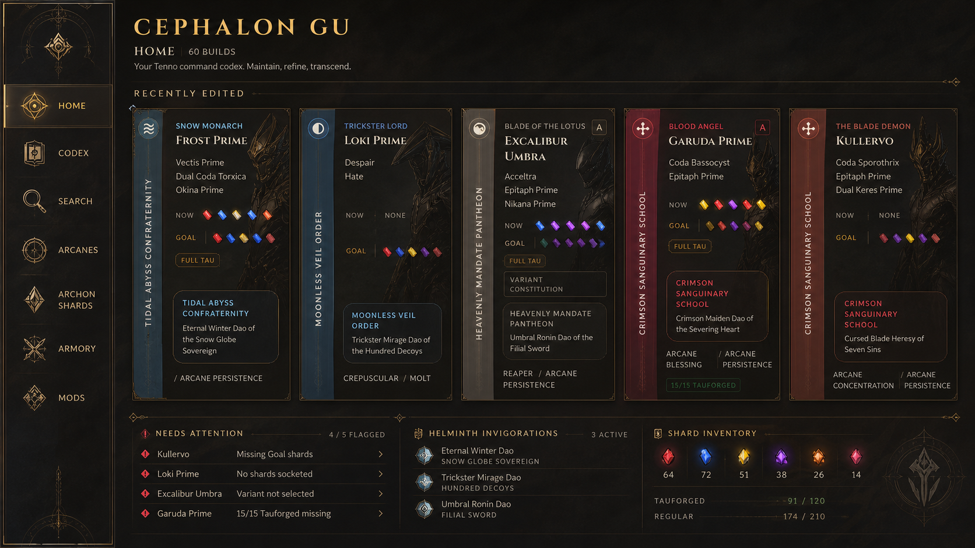
CEPHALON GU
HOME
06
Home becomes an authored starting point, not a panel collection
BEFORE
DIRECTION
Competing filter, summary, heading, and cards
Command rail, seasonal masthead, clear recent-build focus
Notes:
[Sources]
- Docs/redesign/before/home-desktop.png
- Docs/redesign/concepts/01-home.png
[/Sources]

Slide 7
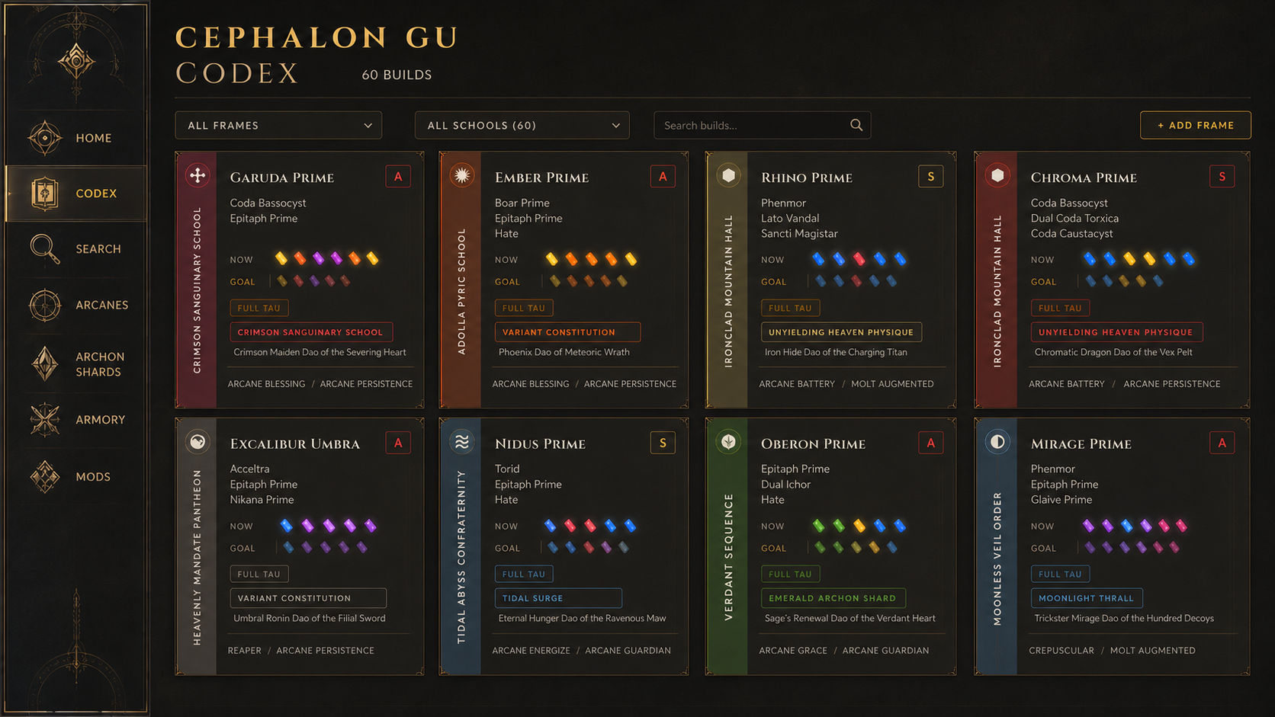
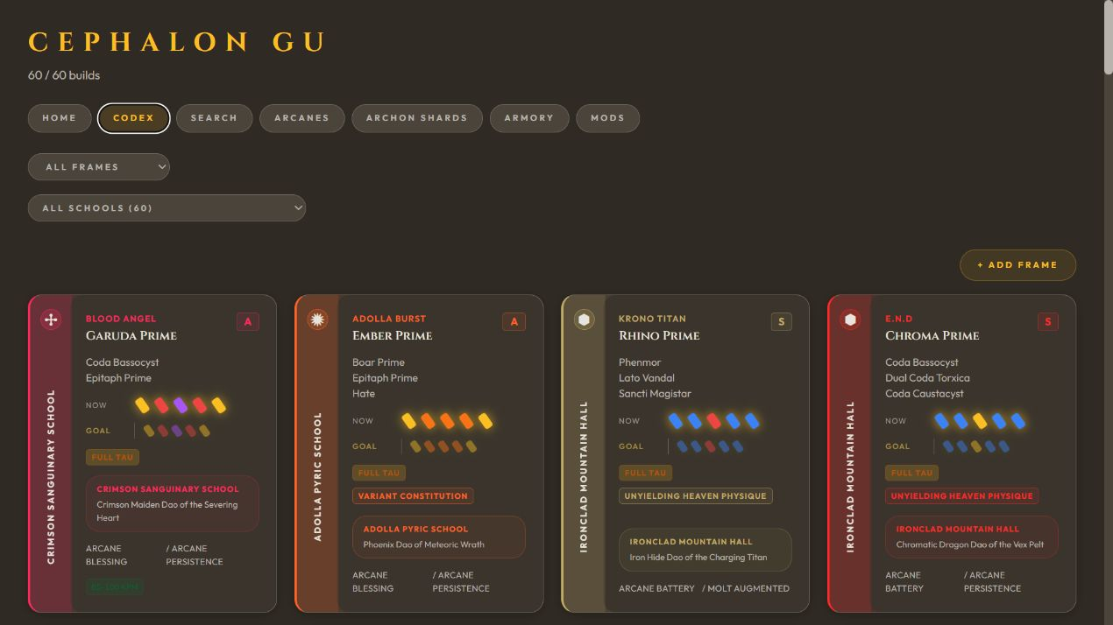
CEPHALON GU
CODEX
07
Codex turns search, context, and results into one task sequence
BEFORE
DIRECTION
Controls and result context require repeated rescanning
One catalog command band with active state and denser artifacts
Notes:
[Sources]
- Docs/redesign/before/codex-desktop.png
- Docs/redesign/concepts/02-codex.png
[/Sources]

Slide 8
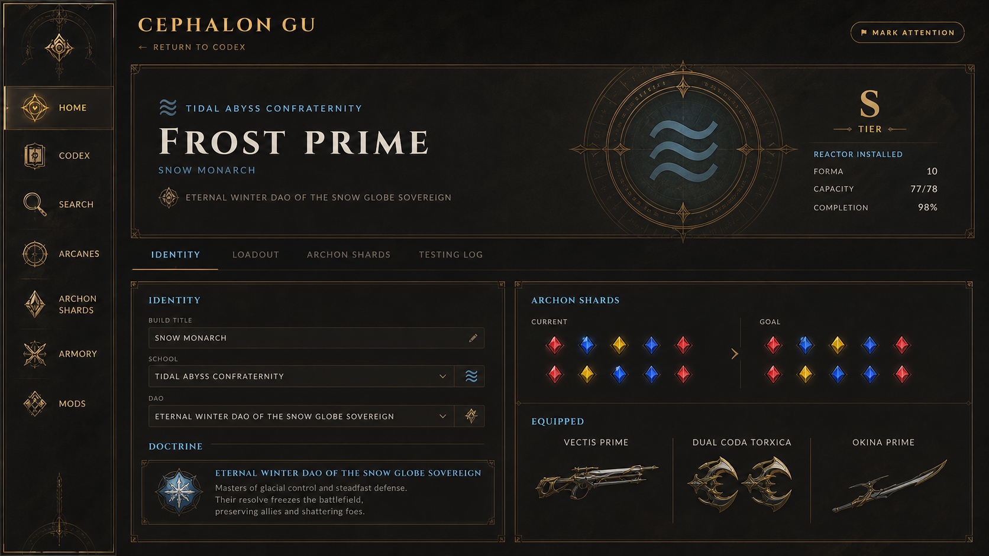
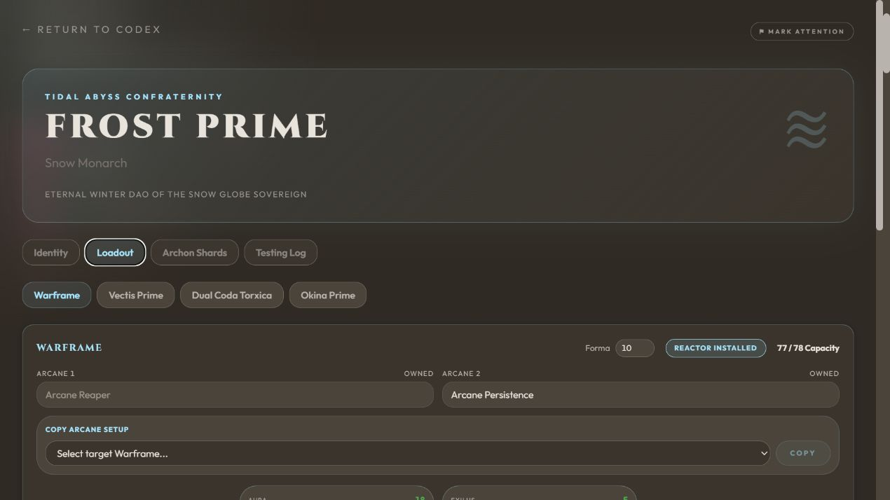
CEPHALON GU
BUILD DETAIL
08
Build detail should behave like a workspace, not an oversized modal
BEFORE
DIRECTION
Overlay navigation and actions compete with build identity
Stable masthead, local sections, and a clear path into Loadout
Notes:
[Sources]
- Docs/redesign/before/build-detail-desktop.png
- Docs/redesign/concepts/03-build-detail.png
[/Sources]

Slide 9
CEPHALON GU
LOADOUT
09
The Arsenal grid becomes the primary instrument
NON-NEGOTIABLE
Exact slot order
2-4-4 for Warframe/Melee
4 × 2 for weapons
Separate Aura/Stance/Exilus
Capacity and polarity stay legible
On narrow screens, preserve the grid as an atomic canvas. Pan it; do not rearrange it into fiction.
Concept text and values are illustrative; slot geometry is the specification.
Notes:
[Sources]
- Docs/redesign/concepts/04-loadout.png
- Docs/redesign/before/loadout-desktop.png
- User-approved Arsenal slot constraints
[/Sources]

Slide 10
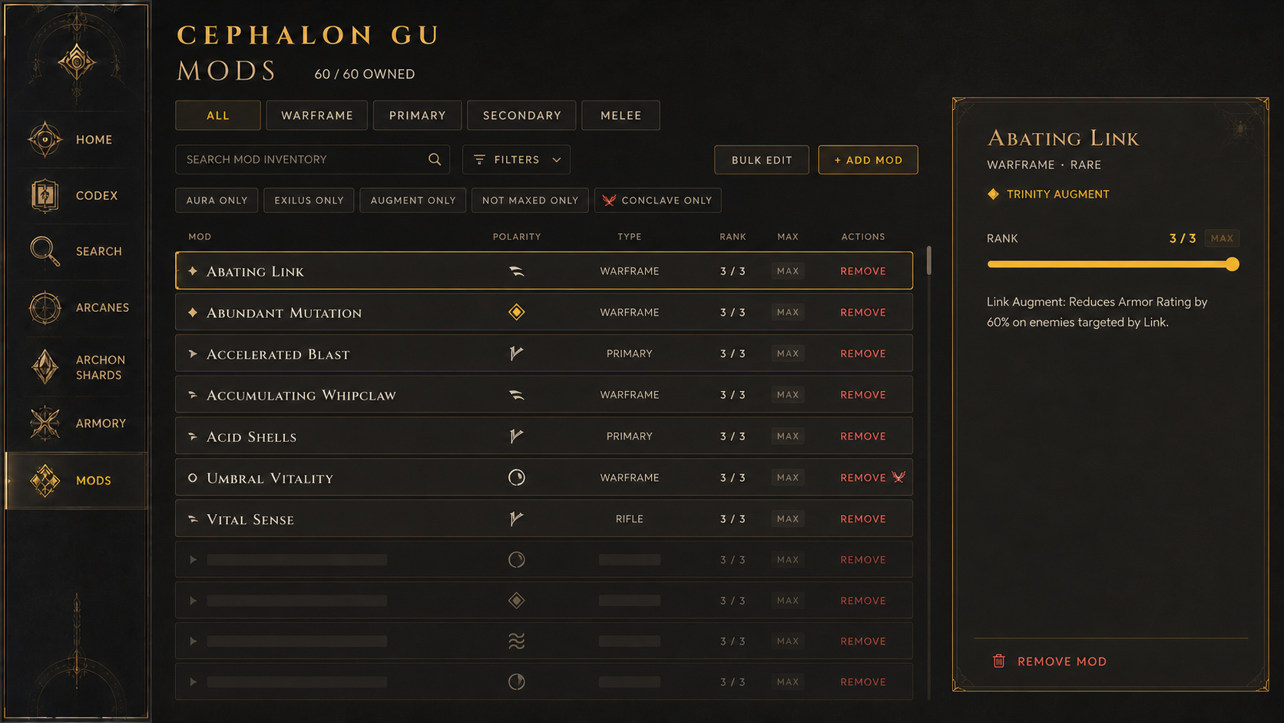
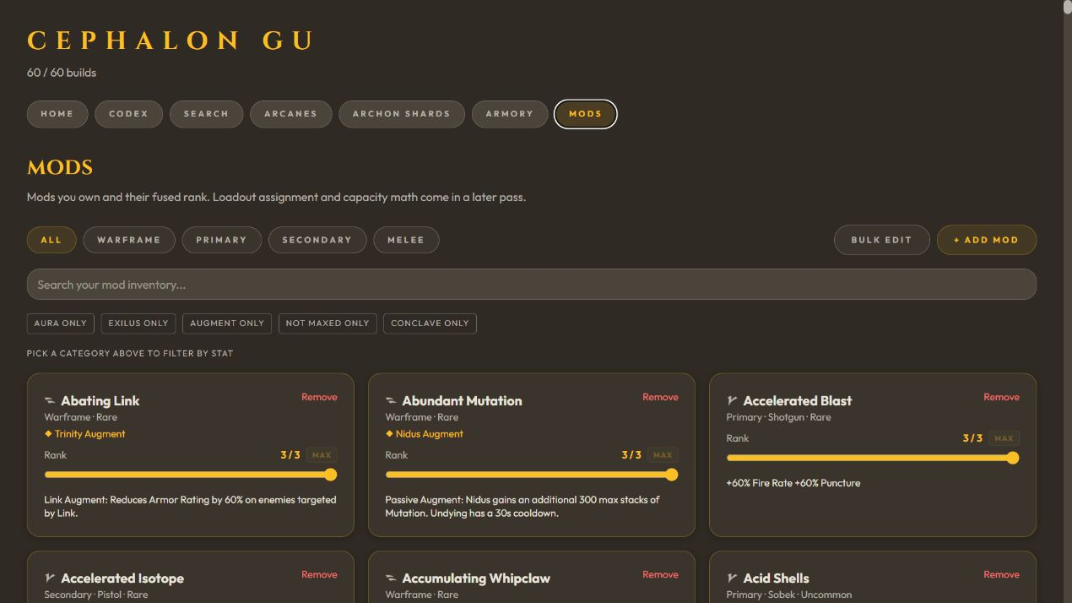
CEPHALON GU
MODS
10
Mods needs a comparative ledger, not three oversized cards
BEFORE
DIRECTION
Large surfaces separate ownership, rank, and action
Stable columns, inline rank control, and one focused inspector
Notes:
[Sources]
- Docs/redesign/before/mods-desktop.png
- Docs/redesign/concepts/05-mods.png
[/Sources]

Slide 11
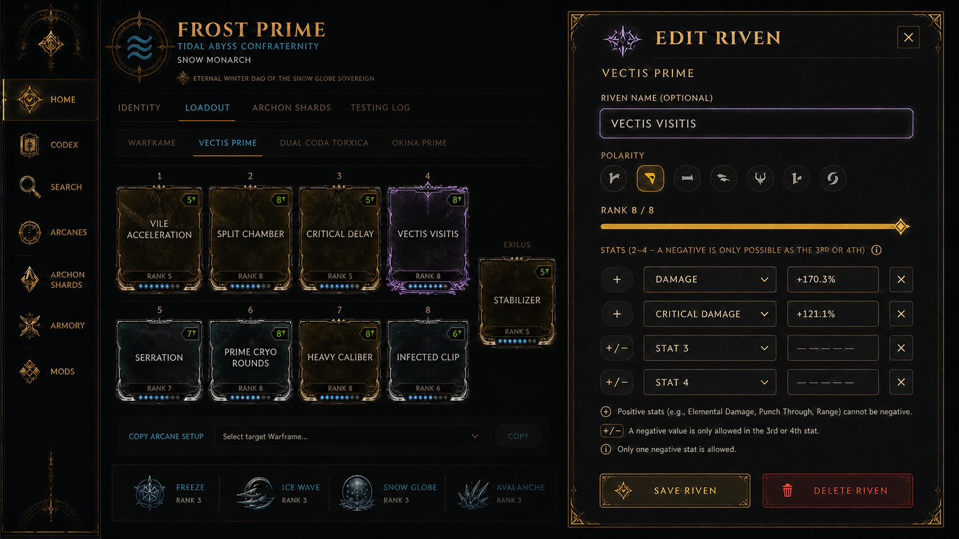
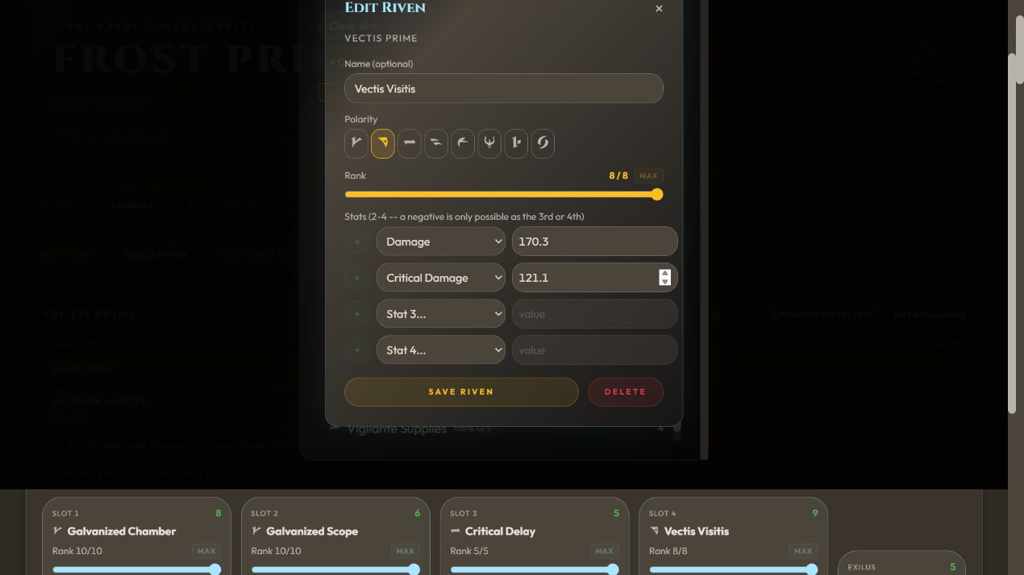
CEPHALON GU
ADD/EDIT RIVEN
11
Riven editing keeps its structured rules and gains a readable sequence
BEFORE
DIRECTION
Weapon, inscription, polarity, rank, and actions share one stack
Weapon context, rule-driven stats, and completion are separated
Notes:
[Sources]
- Docs/redesign/before/riven-editor-desktop.png
- Docs/redesign/concepts/06-riven-editor.png
[/Sources]

Slide 12
CEPHALON GU
IMPLEMENTATION
12
Approve the system first; migrate the product in controlled layers
0
1
2
3
4
5
STABILIZE
SHELL
DISCOVERY
BUILD
INVENTORY
HARDEN
Lint, smoke tests, state fixtures
Tokens, navigation, accessible primitives
Home and Codex
Detail, Loadout, Riven
Mods and Armory
Responsive, a11y, performance
APPROVAL GATES
1 Cultivated Arsenal direction and command rail
2 Six-concept scope; Armory reuses the inventory ledger
3 URL-backed navigation
4 Graceful mobile compatibility; exact grids stay atomic
5 Mocked no-write fixtures for rare and destructive states
NO APPLICATION CODE
HAS CHANGED
Approval starts implementation. It does not expand product scope.
Notes:
[Sources]
- Docs/redesign/Cephalon Gu Redesign Report.md
[/Sources]

